Slide 1
Data Exploration for Cab Firm Investment
Data Glacier Internship Presentation
21/04/23

Slide 2
Summary/Approach
Pink Cab and Yellow Cab are two taxi companies in the US with nation-wide operations
We have identified the most profitable company and performed an exploratory data analysis on the potential market factors driving each company’s success
These include price charged versus cost of operations, distances travelled, demographic information (customers + city data) as well as seasonality
Factors are discussed and they determine the strength of investment recommendation

Slide 3
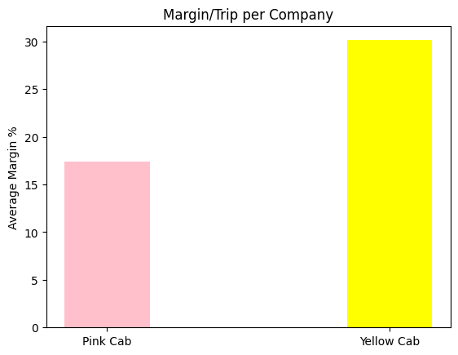
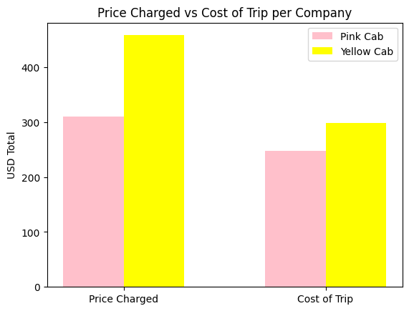
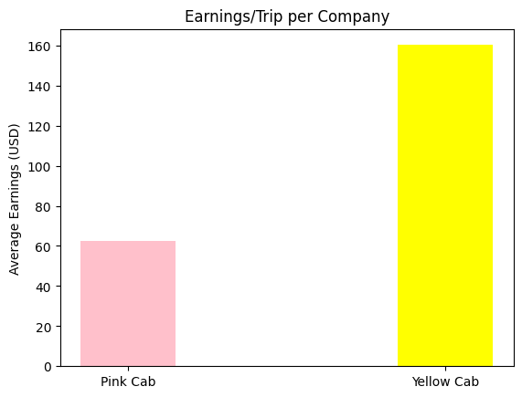
Margin/Trip vs Earnings/Trip vs Price of Trip vs Cost of Trip
Yellow Cab is more profitable (in both margin and earnings per trip) – they charge more trip compared to how much they spend (the costs are more similar between the two companies).
The earnings/trip of Yellow cab are 2.56 times greater than that of Pink Cab while the margin/trip of Yellow cab is only 1.73 times greater than that of Pink Cab
Earnings/ Trip calculated as Price Charged – Cost of Trip (averaged across all trips)
Margin/Trip calculated as (Earnings/Trip)/Price Charged – in slide 1 the average across trips is multiplied by 100 to give percentage

Slide 4
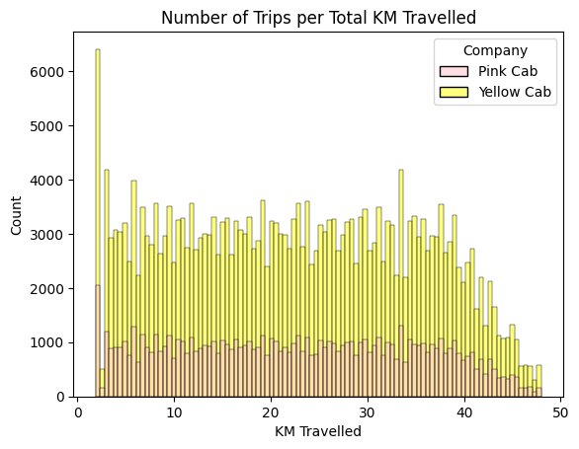
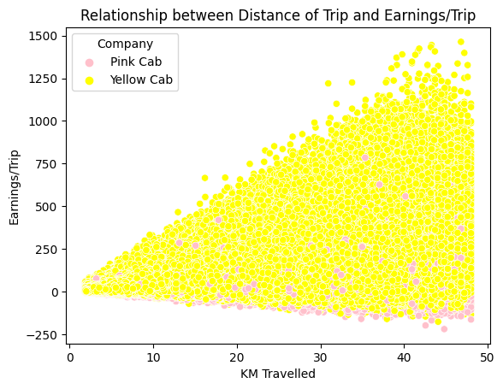
The number of recorded trips for Yellow Cab is much greater than that of Pink Cab (274681 compared to 84711).
However, the distribution of long to short trips is comparable across the two companies (both make more short trips compared to long).
The correlation between the distance of the trip and earnings is much stronger for Yellow Cab than for Pink Cab, and Pink have a lot more negative earnings, indicating a potential problem with the business model.

Slide 5
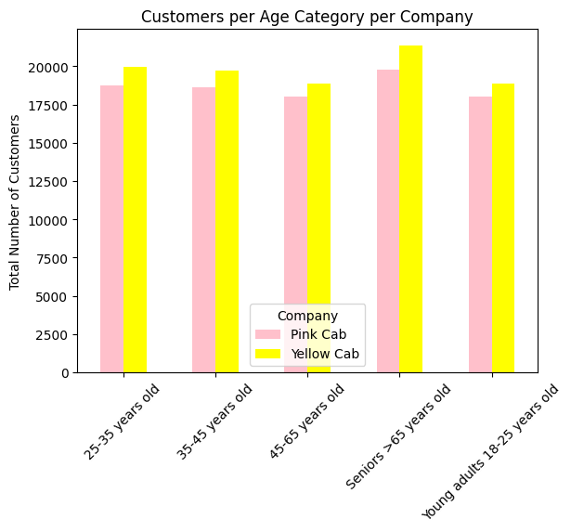
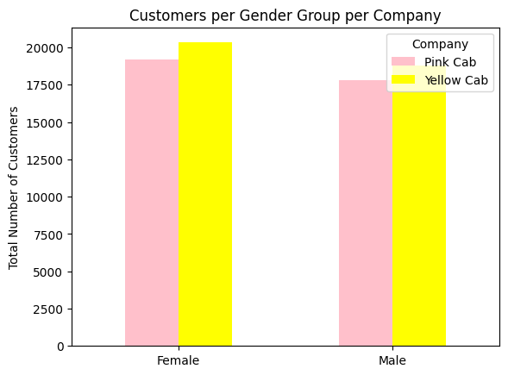
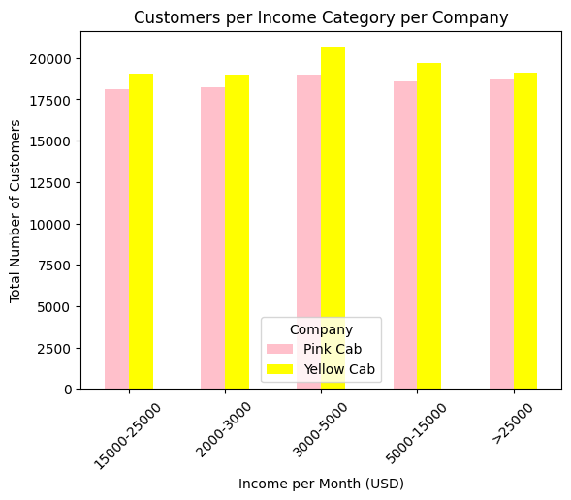
Demographics: Age, Gender and Income Data
The total number of senior customers seems to be slightly greater than other age groups for both companies
Both companies seem to attract nearly equal amounts of customers from the different demographic groups

Slide 6
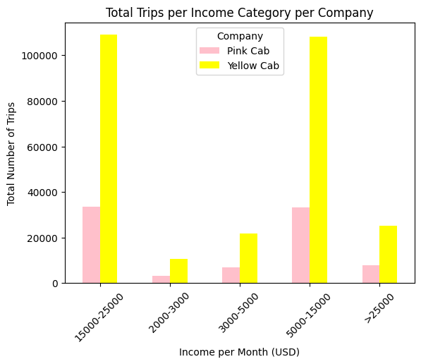
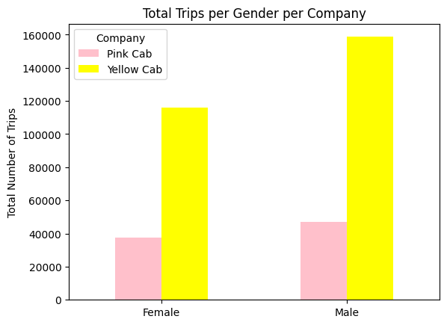
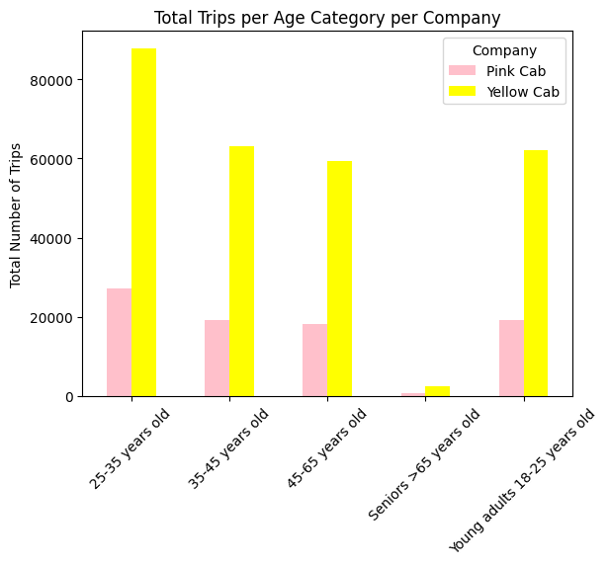
Even though the number of customers is almost equal across demographic groups for both companies, the most number of trips are taken by young and middle aged people (between 25 – 65 years old); the same customers from these age ranges utilise cab services more repeatedly than seniors
Most trips are also being taken by those with monthly incomes between 5000 and 25000 USD per month
There are no differences in the demographic trends across total number of trips for each company

Slide 7
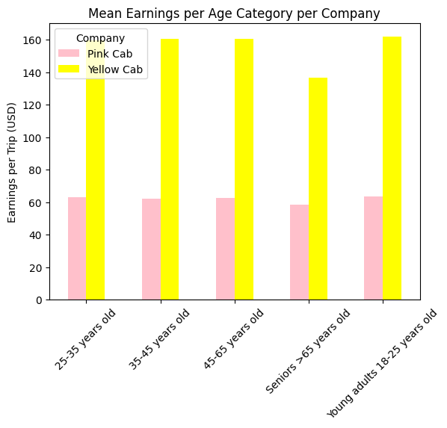
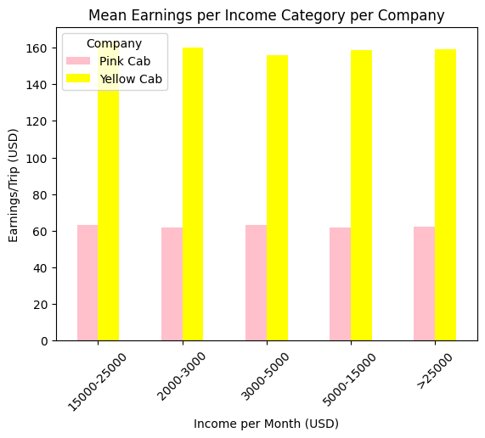
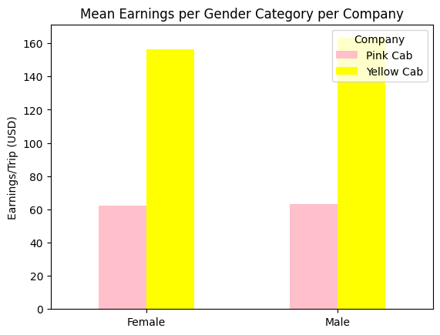
Mean Earnings/Trip are also the same for each company from all of the investigated demographic groups. This is important because certain demographic groups may be more likely to leave tips, or the company may be catering to a particular group more. However, this is not the case.

Slide 8
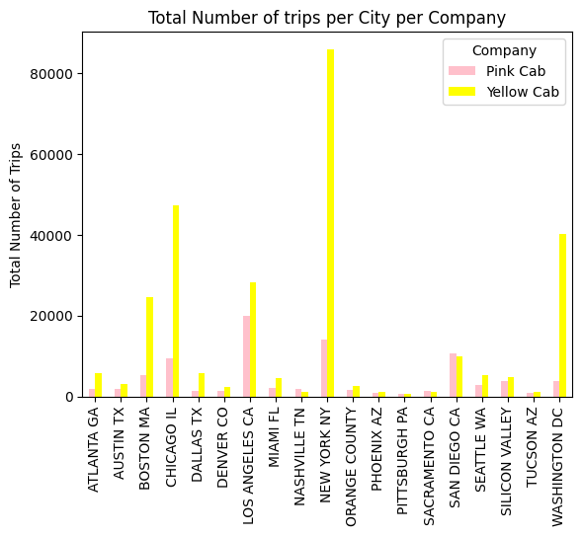
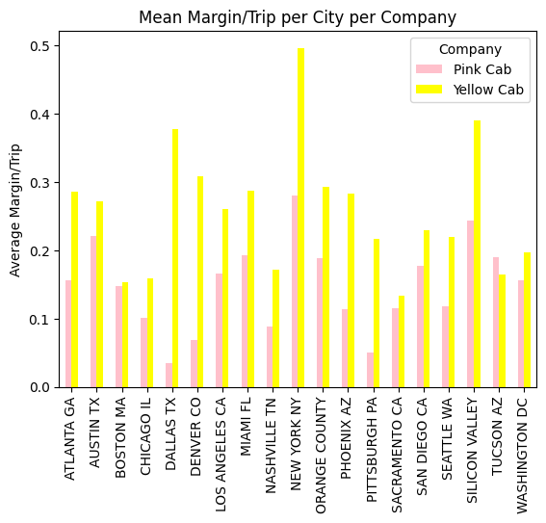
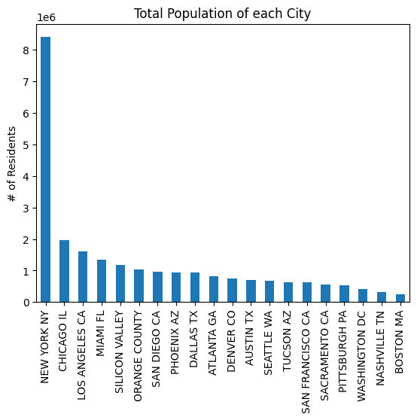
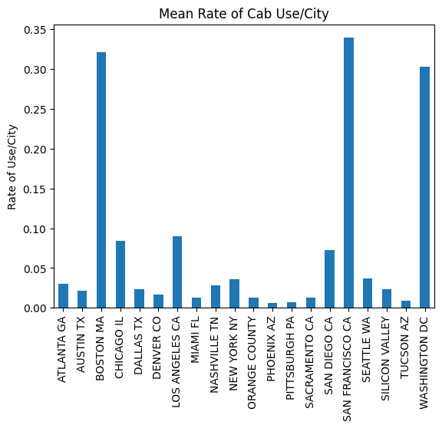
Cab Firm Success per City

Slide 9
Cab Firm Success per City
Both companies seem to be relatively profitable in New York City, which has the highest population – this is where Yellow Cab makes the highest margins and has the most number of trips; this is also where Pink makes its highest margin/trip, but this is not noticeably larger than in other cities (like Tucson AZ), and it is not where it makes the most number of trips (this is Los Angeles for Pink Cab)
Yellow Cab seems to be more successful in cities where Pink Cab isn’t so successful, such as Dallas and Denver (in terms of margin/trip) and Chicago (number of trips)
Both companies seem to perform more similarly in cities with higher rates of cab use, such as Boston and Washington DC
Pink Cab outperforms Yellow Cab in terms of margin/trip in Tucson AZ
Population and rate of use/city seem to influence company success but only moderately; other city-related factors need to be investigated

Slide 10
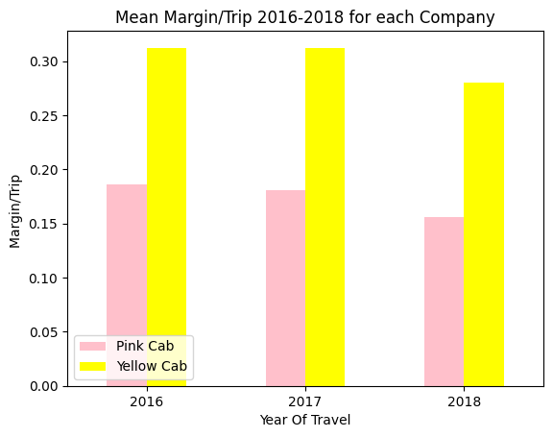
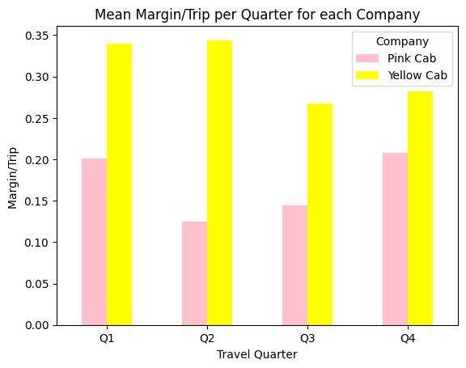
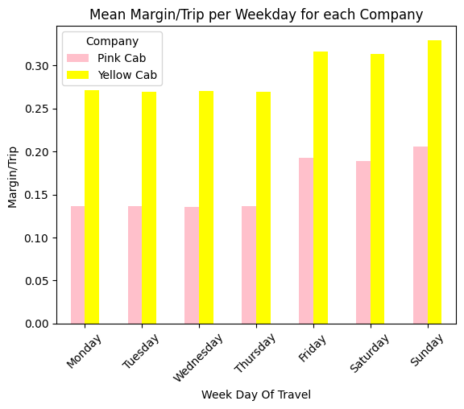
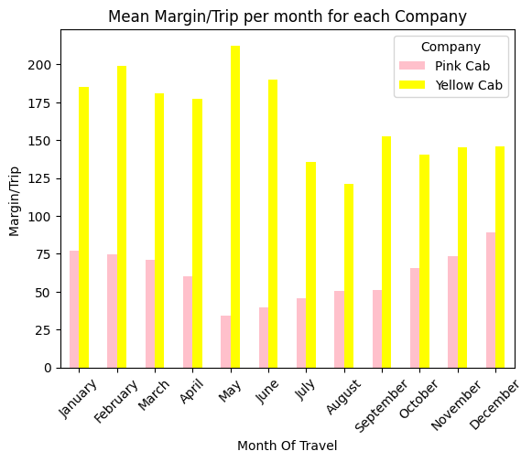
Seasonality and Cab Firm Success

Slide 11
Seasonality and Cab Firm Success
Total margins are higher for Yellow Cab than Pink Can irrespective of year, quarter, month or day of the week
Both companies follow similar trends for year and day of the week: they both had lower average margins/trip in 2018 compared to 2016 and 2017 and have higher margins/trip during the weekend (Friday – Sunday, peaking on Sunday) compared to week days (Monday – Thursday)
However, different trends can be observed for quarters and months of use: peak margins for Yellow Cab are in quarters 1 and 2 (January – June), while for Pink Cab they are in Q1 and Q4 (October – March, the colder months)
Peak margins/trip/month for Yellow Can are in May (lowest margins/trip for Pink Cab) and in December for Pink Cab (lowest margins/trip for Yellow Can are in August)

Slide 12
Conclusions and future suggestions
Yellow Cab is a more profitable company than Pink Cab
Demographics such as age, gender and income category do not seem to impact each company’s success differently
The two companies have different rates of success in different cities
Yellow Cab also seems to be more profitable in warmer months
City and seasonality may be predictors of each company’s success, it would be interesting to explore why and whether they are somehow related
e.g., Pink Cab also does better in cities with a warmer climate, such as LA and San Diego, but Yellow Cab also does very well in places such as Dallas and Denver, and in warmer months → How does each company deal with climate issues? This may not be apparent from the existing data
More needs to be investigated about each company’s business model, but Yellow Cab is the obvious recommendation for investment

